Slide 1
Chapter 8 – Parameter Initialization and Training Sets

Slide 2
In This Chapter
Training parameters vs hyperparameters
Parameters initialization
Training, validation, and testing sets
Common pitfalls in the training data split
Cross-validation
Data augmentation

Slide 3
Parameters vs Hyperparameters

Slide 4
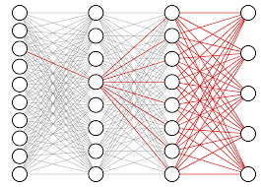
Training of a Neural Network
A neural network training is a complex process that requires thorough organization and well-thought procedures.
Actually, each neuron in the first layer impacts on the outcome results, thus influencing the overall neural network performance.
Training process is a quite empirical process that depends on some general rules as well as on the experience
Neural network training process includes training, validation, and testing.

Slide 5
Parameters vs Hyperparameters
Parameters allow the model to learn the rules from the data while hyperparameters define the system architecture and control how the model is trained.
Parameters learn their own values from data.
In contrast, hyperparameters do not learn their values from data. They are set manually to define the model before training.
The model can be tuned by manually adjusting hyperpatameters to optimize training.
MNN Hyperparameters:
Number of layers L
Number of neurons in each layer N_{S}
Activation functions
Learning rate r
Initial conditions
Number of iterations
Criteria
Many other – we will find out later in the course
MNN Parameters:
W^{[1]} , b^{[1]} ,
W^{[2 ]} , b^{[2]} ,
…,
W^{[L ]} , b^{[L]}

Slide 6
ANN Building and Training Process (1/2)
Phase 1: Building ANN
At this phase, the decision on the neural network architecture is made and the hyperparameters are set.
Phase 2: Initializing W and b in each layer
If an ANN is being trained from scratch, W and b should be initialized in each layer of the ANN.
For the additional training, the current parameters W and b are used.
Phase 3: Training
Training involves finding optimal parameters W and b to achieve the best ANN performance.
The ANN hyperparameters stay unchanged during training

Slide 7
ANN Building and Training Process (2/2)
Phase 4: Validation (Tuning)
At the validation and tuning phase, the hyperparameters may vary to achieve the best ANN performance for the give problem.
Phase 5: Testing
At the testing phase, the trained and validated ANN is being tested on the accurate data to test the performance and accuracy.

Slide 8
Parameters Initialization
W ^{[1]}
W ^{[2]}
W ^{[3]}
W ^{[L]}
x₁
x₂
…
a
A
x_{Nx}
Target output Y
N_{X}
N₁
N₂
N₃
N_{L}
Input X
Hidden layer [1]
Hidden layer [2]
Hidden layer [3]
Output layer [L]
Output A
https://www.deeplearning.ai/ai-notes/initialization/index.html

Slide 9
Initializing Neural Networks
Initialization can have a significant impact on convergence in training deep neural networks.
Simple initialization schemes have been found to accelerate training, but they require some care to avoid common pitfalls.
W ^{[1]}
W ^{[2]}
W ^{[3]}
W ^{[L]}
x₁
x₂
…
a
A
x_{Nx}
Target output Y
N_{X}
N₁
N₂
N₃
N_{L}
Input X
Hidden layer [1]
Hidden layer [2]
Hidden layer [3]
Output layer [L]
Output A
There are the following issues related to the neural network initialization:
The importance of effective initialization
The problem of exploding or vanishing gradients
What is proper initialization?
Mathematical justification for Xavier initialization

Slide 10
I. The Importance of Effective Initialization (1/2)
To build a machine learning algorithm, usually you’d define an architecture (e.g. Logistic regression, Support Vector Machine, Neural Network) and train it to learn parameters. Here is a common training process for neural networks:
Initialize the parameters
Choose an optimization algorithm
Repeat these steps:
Forward propagate an input
Compute the cost function
Compute the gradients of the cost with respect to parameters using backpropagation
Update each parameter using the gradients, according to the optimization algorithm

Slide 11
I. The Importance of Effective Initialization (2/2)
Then, given a new data point, you can use the model to predict its class.
The initialization step can be critical to the model’s ultimate performance, and it requires the right method. To illustrate this, consider the three-layer neural network below. You can try initializing this network with different methods and observe the impact on the learning.
Go to the link below to see the animation on the importance of the effective initialization:
https://www.deeplearning.ai/ai-notes/initialization/index.html

Slide 12
II. The Problem of Exploding or Vanishing Gradients
Consider this 9-layer neural network.
At every iteration of the optimization loop (forward, cost, backward, update), we observe that backpropagated gradients are either amplified or minimized as you move from the output layer towards the input layer.
This result makes sense if you consider the following example.
Assume all the activation functions are linear (identity function). Then the output activation is:
a​ = a^{[L]} = W^{[L]}W^{[L−1]}W^{[L−2]}…W^{[3]}W^{[2]}W^{[1]}X
What would be the outcome of initialization values that were too small, too large or appropriate?
x₁
a
x₂

Slide 13
III. The Problem of Exploding or Vanishing Gradients Case 1: A too-large initialization leads to exploding gradients
Consider the case where every weight is initialized slightly larger than the identity matrix.
This simplifies to a=W^{[L]}1.5^{L−1}x, and the values of a^{[s]} increase exponentially with s (s is the layer index) because each W^{[s]} is the amplifying identity matrix with factor 1.5 > 1.
When these activations are used in backward propagation, this leads to the exploding gradient problem.
That is, the gradients of the cost with the respect to the parameters are too big.
This leads the cost to oscillate around its minimum value.

Slide 14
III. The Problem of Exploding or Vanishing Gradients Case 2: A too-small initialization leads to vanishing gradients
Similarly, consider the case where every weight is initialized slightly smaller than the identity matrix.
This simplifies to a = W^{[L]}0.5^{L−1}x, and the values of the activation a^{[s]} decrease exponentially with ll. When these activations are used in backward propagation, this leads to the vanishing gradient problem.
The gradients of the cost with respect to the parameters are too small, leading to convergence of the cost before it has reached the minimum value.
All in all, initializing weights with inappropriate values will lead to divergence or a slow-down in the training of your neural network.
Although we illustrated the exploding/vanishing gradient problem with simple symmetrical weight matrices, the observation generalizes to any initialization values that are too small or too large.

Slide 15
III. The Problem of Exploding or Vanishing Gradients Case 3: How to find appropriate initialization values (1/3)
To prevent the gradients of the network’s activations from vanishing or exploding, we will stick to the following rules of thumb:
The mean of the activations should be zero.
The variance of the activations should stay the same across every layer.
Under these two assumptions, the backpropagated gradient signal should not be multiplied by values too small or too large in any layer. It should travel to the input layer without exploding or vanishing.
More concretely, consider a layer ll. Its forward propagation is:
A^{[s−1]} = g^{[s−1]}(Z^{[s−1]})
Z^{[s]} = W^{[s]} A^{[s-1]} + b^{[s]}
A^{[s]} = g^{[s]}(Z^{[s]})

Slide 16
III. The Problem of Exploding or Vanishing Gradients Case 3: Continue from the previous slide (2/3)
We would like the following to hold:
E[A^{[s−1])}] = E[A^{[s]}]
Var(A^{[s-1]}) = Var(A^{[s]})
Ensuring zero-mean and maintaining the value of the variance of the input of every layer guarantees no exploding/vanishing signal, as we’ll explain in a moment.
This method applies both to the forward propagation (for activations) and backward propagation (for gradients of the cost with respect to activations).

Slide 17
III. The Problem of Exploding or Vanishing Gradients Case 3: Continue from the previous slide (3/3)
The recommended initialization is Xavier initialization (or one of its derived methods), for every layer s:
W^{[s]} ~ N(μ=0, σ² = 1/n^{[s−1]})
In other words, all the weights of layer ll are picked randomly from a normal distribution with mean μ = 0 and variance σ² = 1/n^{[s−1]} where n^{[s−1]} is the number of neuron in layer [s−1].
Biases are initialized with zeros.
The visualization available at the link below illustrates the influence of the Xavier initialization on each layer’s activations for a five-layer fully-connected neural network.
https://www.deeplearning.ai/ai-notes/initialization/index.html

Slide 18
IV. Justification for Xavier Initialization (1/7)
In this section, we will show that Xavier Initialization keeps the variance the same across every layer.
We will assume that our layer’s activations are normally distributed around zero.
Sometimes it helps to understand the mathematical justification to grasp the concept, but you can understand the fundamental idea without the math.
Let’s work on the layer [s] described in part (III) and assume the activation function is tanh.
The forward propagation is:
Z^{[s]} = W^{[s]}A^{[s−1])} + b^{[s]}
A^{[s]} = tanh(Z^{[s]})

Slide 19
IV. Justification for Xavier Initialization (2/7)
The goal is to derive a relationship between Var(A^{[s−1]}) and Var(A^{[s]}). We will then understand how we should initialize our weights such that:
Var(A^{[s−1]}) = Var(A^{[s]})
Assume we initialized our network with appropriate values and the input is normalized. Early on, we are in the “linear range” of tanh. Values of z are small enough and thus tanh(Z^{[s]}) ≈ Z^{[s]}, meaning that:
Var(A^{[s−1]}) = Var(Z^{[s]})
Moreover, Z^{[s]} = W^{[s]}A^{[s−1])} + b^{[s]} = vector(z₁^{[s]}, z₂^{[s]},…, z_{n}^{[s]}​) where
For simplicity, let’s assume that b^{[s]} =0 (it will end up being true given the choice of initialization we will choose). Thus, looking element-wise at the previous equation Var(A ^{[s−1]}) = Var(A ^{[s]}) now gives:

Slide 20
IV. Justification for Xavier Initialization (3/7)
A common math trick is to extract the summation outside the variance. To do this, we must make the following three assumptions:
Weights are independent and identically distributed
Inputs are independent and identically distributed
Weights and inputs are mutually independent
Thus, now we have:
Another common math trick is to convert the variance of a product into a product of variances. Here is the formula for it:
Var(XY) = E[X]²Var(Y) + Var(X)E[Y]² + Var(X(Var(Y)

Slide 21
IV. Justification for Xavier Initialization (4/7)
Using this formula with X = w_{kj}^{[s]} and Y = a_{j}^{[s-1]}​, we get:
Var(w_{kj}^{[s]}a_{j}^{[s-1]}) = E[w_{kj}^{[s]}]²Var(a_{j}^{[s-1]})+Var(w_{kj}^{[s]})E[a_{j}^{[s-1]}]²+Var(w_{kj}^{[s]})(Var(a_{j}^{[s-1]})
We’re almost done! The first assumption leads to E[w_{kj}^{[s]}]² = 0 and the second assumption leads to E[a_{j}^{[s-1]}]² = 0 because weights are initialized with zero mean, and inputs are normalized. Thus:
The equality above results from our first assumption stating that:
Var(w_{kj}^{[s]}) = Var(w₁₁^{[s]}) = Var(w₁₂^{[s]}) = … = Var(W_{j}^{[s]})
Similarly the second assumption leads to:
Var(w_{kj}^{[s-1]}) = Var(w₁₁^{[s-1]}) = Var(w₁₂^{[s-1]}) = … = Var(W_{j}^{[s-1]})
With the same idea:
Var(Z^{[s]}) = Var(z_{k}^{[s]})

Slide 22
IV. Justification for Xavier Initialization (5/7)
Wrapping up everything, we have:
Var(A^{[s]}) = n^{[s-1]}Var(W^{[s]})Var(A^{[s-1]})
Voilà! If we want the variance to stay the same across layers (Var(A^{[s]})=Var(A^{[s-1]}), we need Var(W^{[s]})=1/n^{[s-1]}.
This justifies the choice of variance for Xavier initialization.
Notice that in the previous steps we did not choose a specific layer ll. Thus, we have shown that this expression holds for every layer of our network. Let [L] be the output layer of our network. Using this expression at every layer, we can link the output layer’s variance to the input layer’s variance:

Slide 23
IV. Justification for Xavier Initialization (6/7)
Wrapping up everything, we have:
Var(A^{[s]}) = n^{[s-1]}Var(W^{[s]})Var(A^{[s-1]})
Depending on how we initialize our weights, the relationship between the variance of our output and input will vary dramatically. Notice the following three cases.
Thus, in order to avoid the vanishing or exploding of the forward propagated signal, we must set n^{[s-1]}Var(W ^{[s]}) = 1 by initializing Var(W ^{[s]}) = 1/n ^{[s-1]}.
Throughout the justification, we worked on activations computed during the forward propagation. The same result can be derived for the backpropagated gradients. Doing so, you will see that in order to avoid the vanishing or exploding gradient problem, we must set n^{[s]}Var(W ^{[s]}) = 1 by initializing Var(W ^{[s]}) = 1/n ^{[s]}.

Slide 24
IV. Justification for Xavier Initialization (7/7)
Conclusion
In practice, Machine Learning Engineers using Xavier initialization would either initialize the weights as N(0,1/n^{[s−1]}) or as N(0,2/(n^{[s−1]} n^{[s]}))
The variance term of the latter distribution is the harmonic mean of n^{[s−1]}​ and n^{[s]}​.
This is a theoretical justification for Xavier initialization. Xavier initialization works with tanh activations. Myriad other initialization methods exist. If you are using ReLU, for example, a common initialization is He initialization (He et al., Delving Deep into Rectifiers), in which the weights are initialized by multiplying by 2 the variance of the Xavier initialization. While the justification for this initialization is slightly more complicated, it follows the same thought process as the one for tanh.
If you are using ReLU, for example, a common initialization is He initialization (He et al., Delving Deep into Rectifiers), in which the weights are initialized by multiplying by 2 the variance of the Xavier initialization.

Slide 25
Training, Validation, and Test Sets

Slide 26
ANN Training, Validation, and Testing
Overall training datasets comprise samples used to fit machine learning models under construction, i.e., carry out the actual AI development.
Constructing these robust pillars of AI involves following best practices.
A representative data set is needed to train a model.
Such a set should have three distinct subsets of data
training set—a subset to train a model.
validation set—a subset to tune up the training process and ANN hyperparameters (structure and architecture).
test set—a subset to test the trained model.

Slide 27
Training Set
Training data are collections of examples or samples that are used to 'teach' or 'train the machine learning model.
The model uses a training data set to understand the patterns and relationships within the data, thereby learning to make predictions or decisions without being explicitly programmed to perform a specific task.
Initially, machine learning development involves starting inputs within specified project parameters.
One of the critical aspects requires the expert setting of weightings between the various connections of so-called neurons within the ML model or estimator.
However, these initial settings are not static; they are modified during the training process based on the feedback received from the model performance.

Slide 28
Validation Set
In contrast, validation datasets contain different samples to evaluate trained ML models.
It is still possible to tune and control the model at this stage.
The validation set is used during the training phase of the model to assess the model's performance and to fine-tune the model's parameters, hyperparameters, and architecture.
This becomes an iterative process wherein the model learns from the training data and is then validated and fine-tuned on the validation set.
A validation dataset tells us how well the model is learning and adapting, allowing for adjustments and optimizations to be made to the model's parameters or hyperparameters before it's finally put to the test.

Slide 29
Test Set
The test set, on the other hand, is used after the model has been fully trained to assess the model's performance on completely unseen data.
A test data set is a separate sample, an unseen (unused) data set, to provide an unbiased final evaluation of a model fit.
The inputs in the test data are similar to the previous stages but not the same data.
The test data set mirrors real-world data the machine learning model has never seen before.
Its primary purpose is to offer a fair and final assessment of how the model would perform when it encounters new data in a live, operational environment.
A test set must be representative and high quality data set as a whole.
During this final evaluation, there is no adjustment of hyperparameters.

Slide 30
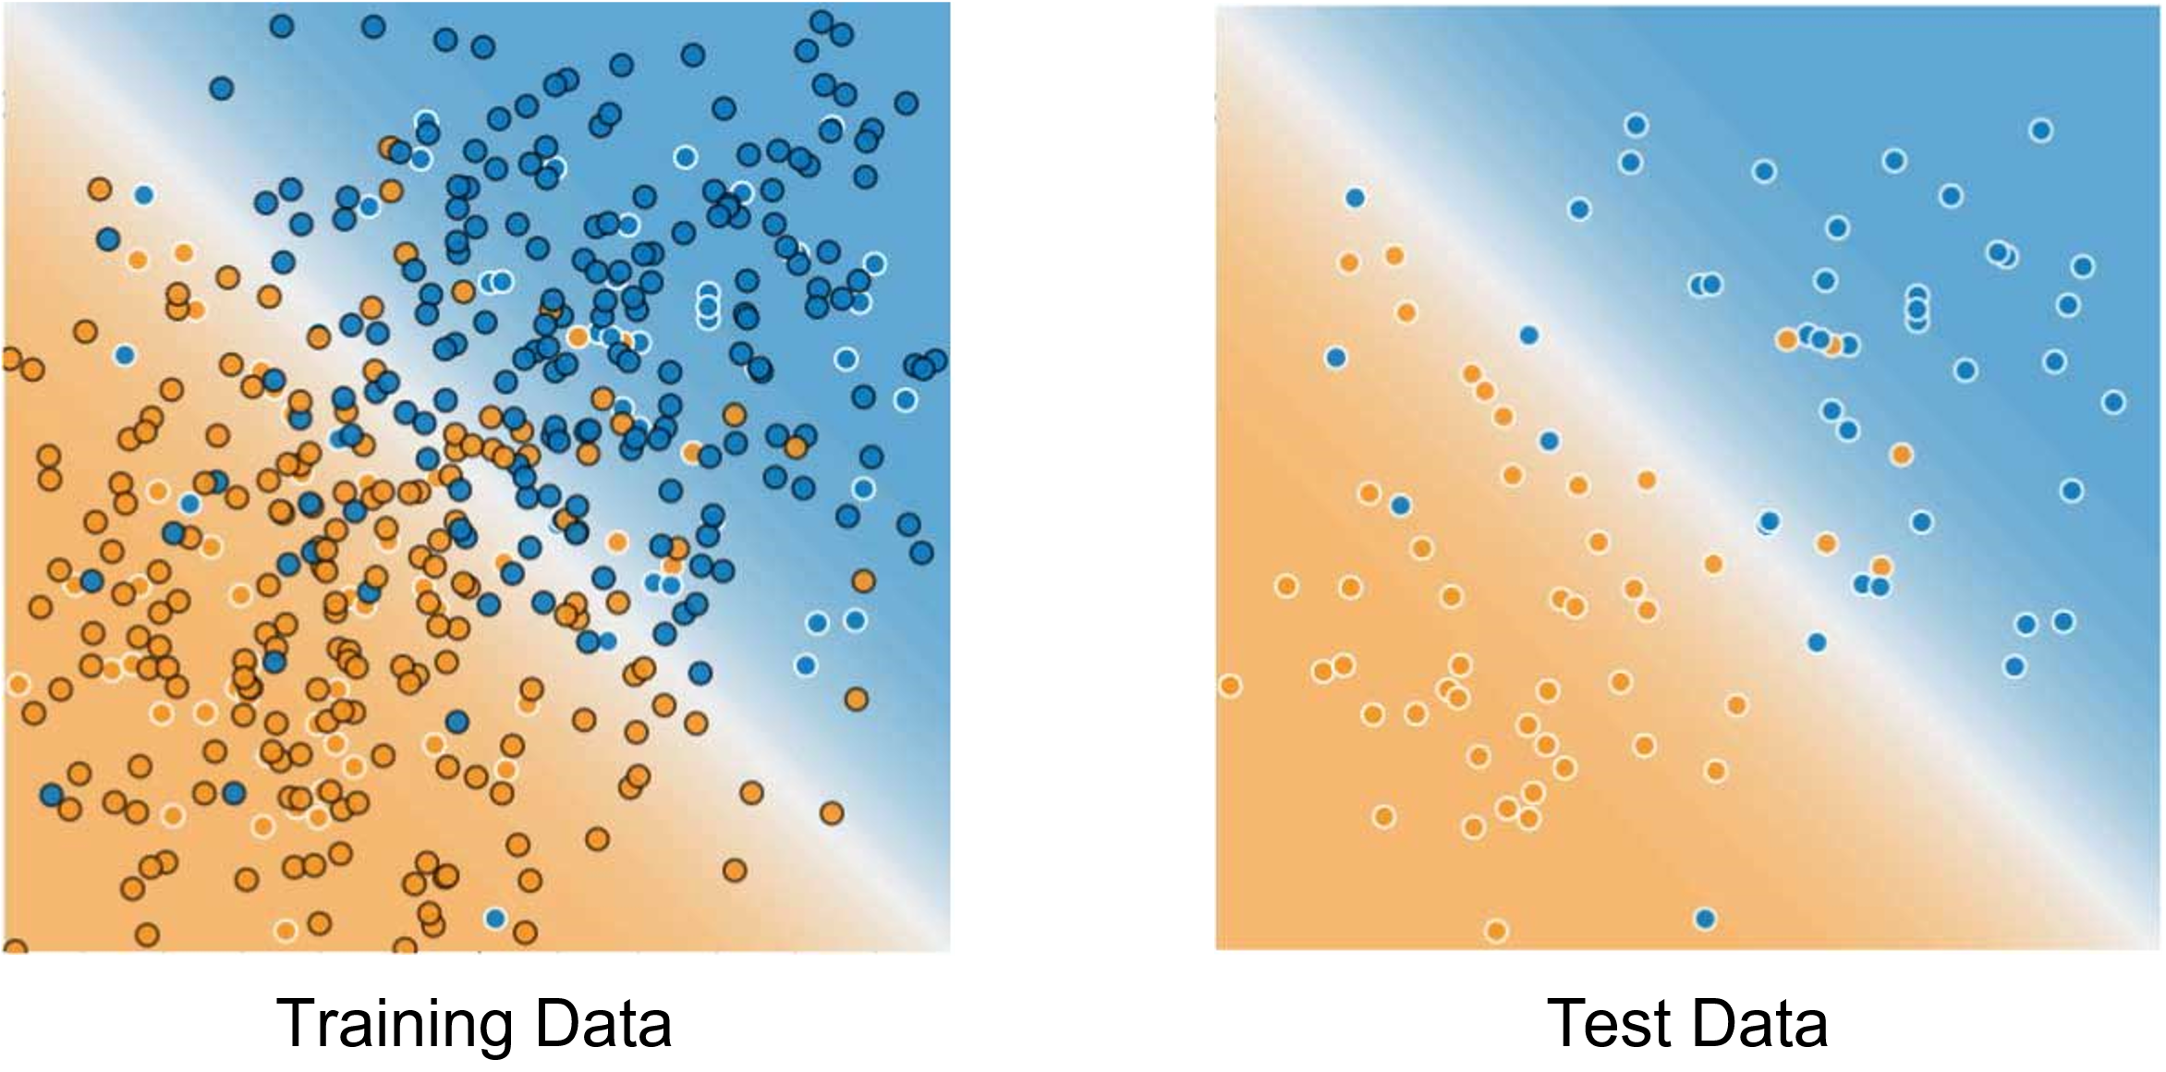
Test vs Training and Validation
In Training
Assuming that your test and validation sets meet the preceding two conditions, your goal is to create a model that generalizes well to new data.
The test set serves as a proxy for new data.
Notice that the model learned for the training data is very simple.
This model doesn't do a perfect job—a few predictions are wrong.
However, this model does about as well on the test data as it does on the training data.
In other words, this simple model does not overfit the training data.
After validation and test

Slide 31
Splitting Data into Train, Verify, and Test
The optimum ratio when dividing records with enough data between each function – train, validate, and test – depends on the application usage, model type, and data dimensions.
Most ML models benefit from having a substantial number of scenarios from which to train.
Thus, a substantial data set should be allocated for training.
At the validation stage, models with few or no hyperparameters are straightforward to validate and tune.
Thus, a relatively small dataset should suffice.
In contrast, models with multiple hyperparameters require enough data to validate likely inputs.
Cross-validation might be helpful in these cases, too.
Generally, apportioning 80 percent of the data to train, 10 percent to validate, and 10 percent to test scenarios ought to be a reasonable initial split.

Slide 32
Activities with Training, Validation, and Testing Sets
Training Stage | Activity
Training | Adjusting ANN parameters
Validation | Tuning ANN hyperparameters and parameters
Testing | Final testing on high quality data. No adjustment or tuning in this stage.

Slide 33
Training Epoch
A validation dataset must not be too small. Otherwise, the ML model will be untuned, imprecise, or even inaccurate.
Epoch in artificial neural networks is one training cycle through a complete dataset.
In particular, the F1 score – a statistical measure of precision and recall – will vary too widely.
One cycle through a complete dataset in artificial neural networks is called an epoch.
And as mentioned earlier, training a model usually takes more than one epoch.
The train-test-validation ratio depends on the usage case.
Getting the procedure right comes with experience.

Slide 34
F₁-Score (1/2)
In statistical analysis of binary classification and information retrieval systems, the F-score or F-measure is a measure of predictive performance.
It is calculated from the precision and recall of the test, where the precision is the number of true positive results divided by the number of all positive results, including those not identified.
The F₁ score is the harmonic mean of the precision and recall.
It thus symmetrically represents both precision and recall in one metric.
The more generic F_{β} score applies additional weights, valuing one of precision or recall more than the other.
The highest possible value of an F-score is 1.0, indicating perfect precision and recall, and the lowest possible value is 0, if either precision or recall are zero.

Slide 35
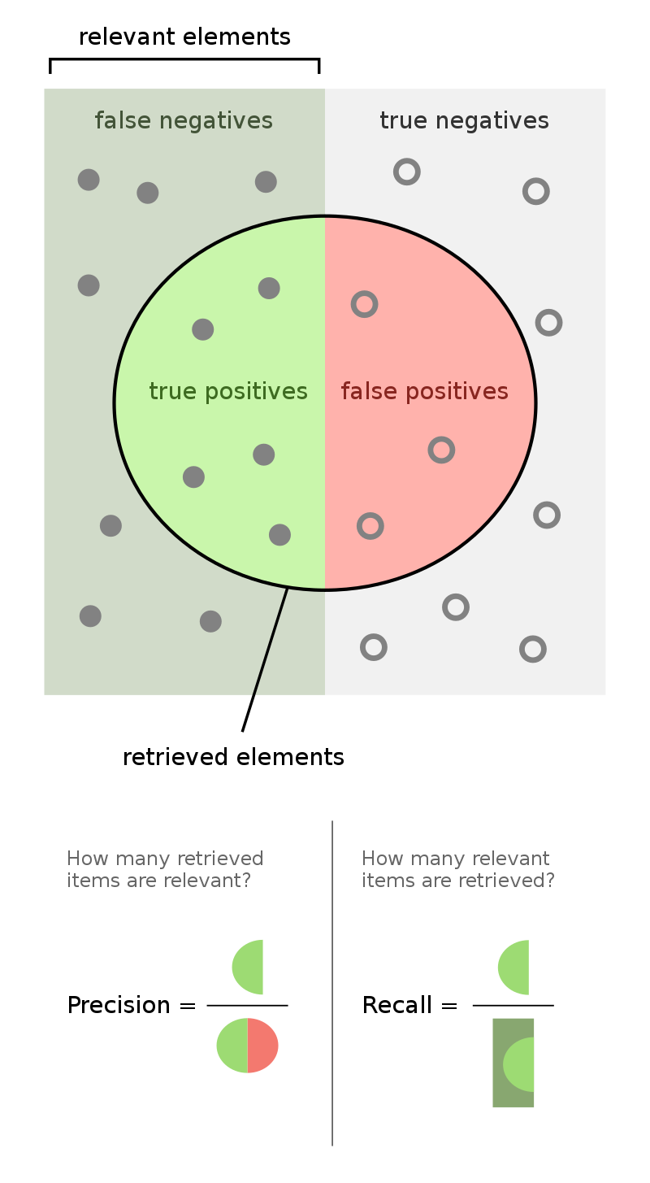
F₁-Score (2/2)

Slide 36
Never Train on Test Data
Never train on test data.
If you are seeing surprisingly good results on your evaluation metrics, it might be a sign that you are accidentally training on the test set.
For example, high accuracy might indicate that test data has leaked into the training set.

Slide 37
Sources for Data Sets
Verification and Test Data should come form the same source.
The major focus is on the quality of data.
Training data may come and appended from different sources.
The major focus is on the amount of samples

Slide 38
Splitting between Training, Validation, and Testing Sets
For example, consider a model that predicts whether an email is spam, using the subject line, email body, and sender's email address as features.
The data into training, validation, and test sets splits with an 80-10-10 ratio.
After training, the model achieves 99% precision on both the training set and the test set.
We'd expect a lower precision on the test set, so we take another look at the data and discover that many of the examples in the test set are duplicates of examples in the training set (we neglected to scrub duplicate entries for the same spam email from our input database before splitting the data).
We've inadvertently trained on some of our test data, and as a result, we're no longer accurately measuring how well our model generalizes to new data.

Slide 39
Splitting in Large Data Sets
With a typical data set size in the rage from 100 to 10,000 samples, the split into training-verification-test subsets can be around 70-15-15 or 80-10-10 to keep a substantial amount of data in the training set and reasonable numbers in the verification and test sets.
In case of large data sets, say, in the rage from 10,000 to 100,000 samples the proportions may change to about 90-5-5 to keep reasonable numbers for the verification and test sets and grow the training set.
In case of very large data sets, say, with over 1,000,000 samples the proportions may change even more to about 98-1-1 to keep reasonable numbers for the verification and test sets and grow the training set.

Slide 40
Split Ratio for Training, Validation, and Test Sets
Splitting data between training, validation, and test sets depends on the data set size.
Data size | Split Ratio
Data size | Training | Validate | Test
100 – 1,000 | 70% | 15% | 15%
10,000 – 100,000 | 90% | 5% | 5%
Over 1,000,000 | 98% | 1% | 1%

Slide 41
Mismatched Train/Test Distribution
In a learning algorithm, a distribution mismatch occurs when the training dataset and the test dataset are not drawn from the same distribution.
This mismatch might also occur if training data is corrupted or if the statistical distribution of the data changes from training to testing.
Validation and Test sets must come from the same distribution.
Training set may come from various sources.

Slide 42
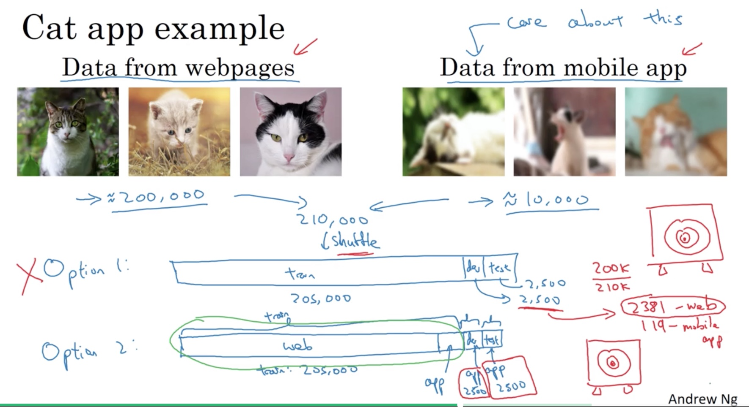
Training and Testing on Different Distributions
From websites
From mobile phone
200,000 images
10,000 images
All
Randomly chosen
Training Set Validation Test
205,000
2,500
2,500
Training set is from different distributions
Validation and Test sets are from the same distribution

Slide 43
Common Pitfalls in the Training Data Split
https://kili-technology.com/training-data/training-validation-and-test-sets-how-to-split-machine-learning-data

Slide 44
Common Pitfalls in the Training Data Split
Common pitfalls in the training data split can be categorized as following:
Cross-Validation
Low-Quality Training Data
Overfitting
Overemphasis on Validation and Test Set Metrics

Slide 45
Common Pitfalls in The Training Data Split: Cross-Validation (1/3)
An alternative approach involves splitting an initial dataset into two halves, training and testing.
Firstly, with the test data set kept to one side, a proportion of randomly chosen training data becomes the actual training set.
The remaining values in the array are for later iterations to validate inputs.
For example, the split might vary from two halves to a ratio of 80:20 percent.
This cross-validation involves one or more splits of the training data set and validation data set.
In particular, K-fold cross-validation aims to maximize accuracy in testing by dividing the source data into several bins or groups.
All except one of these are for training and validation purposes.
The last is for testing.

Slide 46
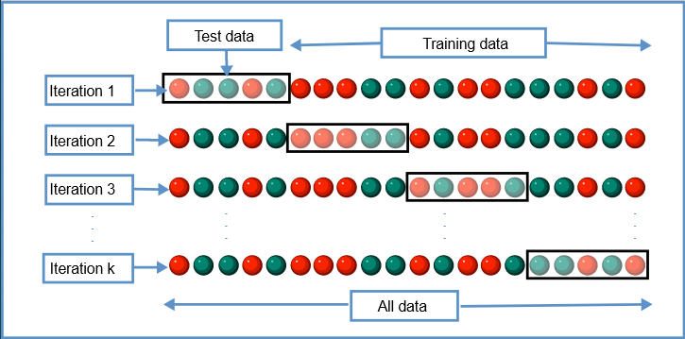
Common Pitfalls in The Training Data Split: Cross-Validation (2/3)

Slide 47
Common Pitfalls in The Training Data Split: Cross-Validation (3/3)
In this method, each data set runs as a separate experiment.
Analysts then calculate the average of all the runs to obtain the mean accuracy.
Once the result falls within specified limits, the final step before signoff is using the remaining fold of test data to double-check the findings.
Other methods of cross-validation are Stratified K-Fold cross-validation to guarantee a suitable representation of each class and avoid bias,
Leave-P-Out cross-validation, which is ideally used for smaller sample sizes because of its high computational demands, and Rolling cross-validation for time series-based data.

Slide 48
Common Pitfalls in The Training Data Split: Low-Quality Training Data (1/2)
Like other areas of IT, machine learning algorithms follow the time-tested principle of GIGO: garbage in, garbage out (GIGO).
So, to ensure reliable and robust algorithms, the following three components are necessary:
Quantity. Sufficient data is important for the model to learn how to interact with users. As an analogy, humans need a considerable amount of information before becoming an expert.
Quality. In themselves, data will not guarantee reliable results. Real-world scenarios and test cases that represent likely conditions are vital. Data should mimic the user input that the new algorithm will receive. It is essential to fold in data on which the application will rely, such as a combination of images, videos, sounds, and voices.
Diversity. ML requires algorithms trained on more than one input fold to simulate most, if not all, likely and possible cases.

Slide 49
Common Pitfalls in The Training Data Split: Low-Quality Training Data (2/2)
Designers should seek to prevent bias in models.
Applications must comply with legislation and should conform to inclusivity guidelines.
They should not display any bias based on personal choice, taste, habits, and norms
They should not display prejudice based on age, race, gender, language, marital status, or other identifying factors.

Slide 50
Common Pitfalls in The Training Data Split: Overfitting
When developing an ML model, an essential principle is that the validation set and test set must remain separate. Otherwise, an overfit might occur.
Overfitting is when exceptional or unreal conditions lead to incorrect outputs.
In other words, the statistical model fits precisely with the inputs used to train it and will probably not be accurate.
Instead, the aim should be to generalize.
The proper application of cross-validation ought to minimize overfitting and ensure that the algorithm's prediction and classification functionality are correct.

Slide 51
Common Pitfalls in The Training Data Split: Overemphasis on Validation and Test Set Metrics
Overfitting can also arise if the development methodology overuses search techniques to look for empirical relationships in the input samples. This approach tends to identify relationships that might not apply in the real world.
As an analogy, it is akin to looking for connections that do not exist between random events. Nonetheless, discerning between occasional coincidences and the emergence of new patterns does involve a delicate balancing act, with careful evaluation of the probabilities involved.
Although a validation set contains different data, it is essential to remember that evaluations should not be too lengthy. Otherwise, the model tends to become more biased as validation data perfuses into the configuration.

Slide 52
Hints on Building Train-Validation-Test Data Set
Quality is paramount for AI to deliver accurate results in the ingenious and expanding field of ML. Sound predictions and stable system behavior require the correct application of various key principles.
Essential considerations when organizing data for test sets are that:
Training data builds the ML algorithm. Analysts feed in information and look for corresponding expected outputs. The import should be within specification and sufficient in quantity.
When validating, it is necessary to use fold-in unseen values. Here, the new inputs and outputs enable ML designers to evaluate how accurate the new model's predictions are.
Overfitting can result from too much searching or excessive amounts of validation data.
While supervised ML approaches use a tag or classifier to identify training records, test records must remain untagged. The same data labels could enable the ML model to single out a shared reference, leading to anomalies in the results.

Slide 53
Data Augmentation

Slide 54
Data Augmentation
Data augmentation is the strategy though not strictly a regularization method, it sure has its place here.
Data augmentation refers to the process of generating new training examples to our dataset.
More training data means lower model’s variance, a.k.a lower generalization error. Simple as that.
It can also be seen as a form of noise injection in the training dataset.
Data augmentation can be achieved in many different ways. Let’s explore some of them:
Basic Data Manipulations
Feature Space Augmentation
GAN-based Augmentation
Meta-Learning

Slide 55
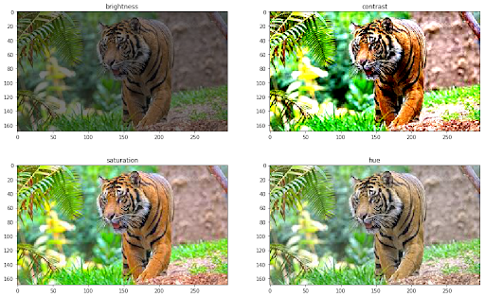
Requirements for Data
The accuracy of deep learning models largely depends on the quality, quantity, and contextual meaning of training data.
However, data scarcity is one of the most common challenges in building deep learning models.
In production use cases, collecting such data can be costly and time-consuming.
Leveraging a low-cost and effective method—data augmentation helps reduce dependency on the collection and preparation of training examples and build high-precision AI models quicker.
https://www.v7labs.com/blog/data-augmentation-guide

Slide 56
The Need for Labeled Data
Deep learning revolutionized numerous fields and has become the state-of-the-art approach to many complex tasks like text translation, image segmentation, and automatic speech recognition.
Large annotated datasets play a critical role in this success since deep learning models need a lot of data to be trained on.
However, it is sometimes difficult and expensive to annotate a large amount of training data.
Therefore, proper data augmentation is useful to increase the model performance.
The data augmentation methods are the same regardless of the domain.

Slide 57
The Goal of Data Augmentation
Generally, the goal of data augmentation is to increase the size of the dataset by changing a property of already existing data or generating completely new synthetic data.
Usually, the former approach is followed where we flip, rotate, or randomly change the hue, saturation, brightness, and contrast of an image.
The procedure is simple and can be done online while training the model.
The disadvantage of using these techniques is that we don’t introduce new synthetic data to the model, but we just include the same samples in a different state.
Hence, the model has already seen these samples, and the impact on generalizability is limited:

Slide 58
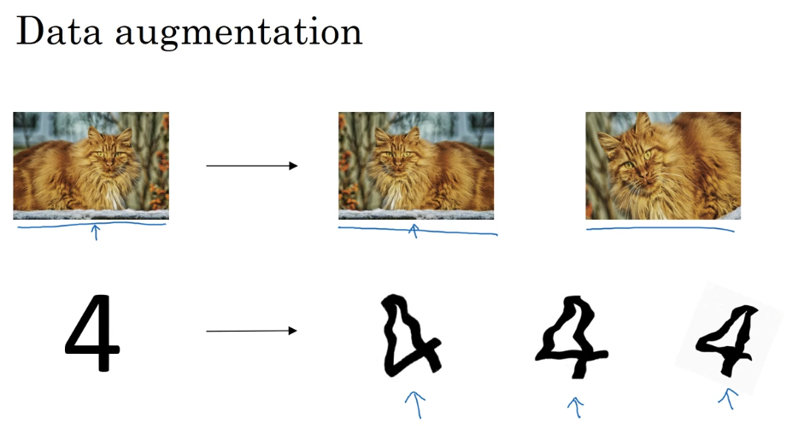
Data Augmentation Example

Slide 59
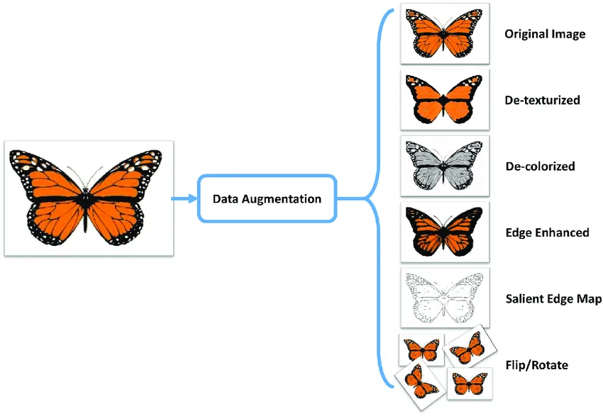
Data Augmentation
Data augmentation is the process of artificially generating new data samples from existing data, primarily to train new machine learning (ML) models.
Data augmentation is a process of artificially increasing the amount of data by generating new data points from existing data.
https://medium.com/secure-and-private-ai-writing-challenge/data-augmentation-increases-accuracy-of-your-model-but-how-aa1913468722

Slide 60
What is Data Augmentation?
This includes adding minor alterations to data or using machine learning models to generate new data points in the latent space of original data to amplify the dataset.
A question may arise about the difference between augmented data and synthetic data.
Synthetic data:
When data is generated artificially without using real-world images.
Synthetic data are often produced by Generative Adversarial Networks
Augmented data:
Derived from original images with some sort of minor geometric transformations (such as flipping, translation, rotation, or the addition of noise) in order to increase the diversity of the training set.

Slide 61

Augmented Data vs Synthetic Data
Today, there are a lot of privacy concerns revolving around data collection and usage.
Hence, many researchers and companies are using synthetic data generation techniques to build datasets.
However, due to limitations such as its lack of resemblance to the original data, augmented data is generally preferred over synthetic data.
Relying on synthetic data only, we may significantly deviate from the real world and dive into a virtual one.

Slide 62


Generative Adversarial Networks – GANs
Generative Adversarial Networks (GANs) are generative models: they create new data instances that resemble your training data.
For example, GANs can create images that look like photographs of human faces, even though the faces don't belong to any real person.
It may happen that you train a neural network to recognize real-world objects using a training set of the generated non-existing objects.

Slide 63
Data Augmentation: Basic Data Manipulations
Basic Data Manipulations: The first simple thing to do is to perform geometric transformations on data.
Most notably, if we’re talking about images, we have solutions such as: Image flipping, cropping, rotations, translations, image color modification, image mixing etc.
Cutout is a commonly used idea where we remove certain image regions.
Another idea, called Mixup, is the process of blending two images from the dataset into one image.

Slide 64
Data Augmentation: Feature Space Augmentation
Feature Space Augmentation : Instead of transforming data in the input space as above, we can apply transformations on the feature space.
For example, an autoencoder might be used to extract the latent representation.
Noise can then be added in the latent representation which results in a transformation of the original data point.

Slide 65
Data Augmentation: GAN-Based Augmentation
GAN-based Augmentation: Generative Adversarial Networks have been proven to work extremely well on data generation, so they are a natural choice for data augmentation.

Slide 66
Data Augmentation: Meta-Learning
Meta-Learning: In meta-learning, we use neural networks to optimize other neural networks by tuning their hyperparameters, improving their layout, and more.
A similar approach can also be applied in data augmentation.
In simple terms, we use a classification network to tune an augmentation network into generating better images.
Example: We feed random images to an Augmentation Network (most likely a GAN), which will generate augmented images.
Both the augmented image and the original are passed into a second network, which compares them and tells us how good the augmented image is.
After repeating the process, the augmentation network becomes better and better at producing new images.

Slide 67
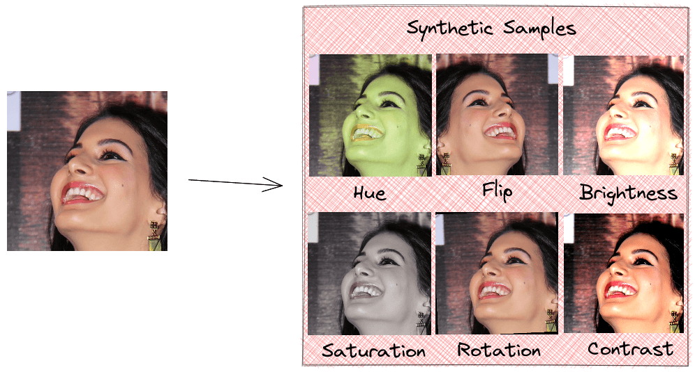
Data Augmentation by Image Adjustment
Augmented images
Original image

Slide 68
Chapter 8 – Parameter Initialization and Training Sets

